Slide 1
Loops
Loops are important in programming because they help you to execute a block of code repeatedly.
You will face situations where you would need to use a piece of code over and over, but you don't want to write the same line of code multiple times.

Slide 2
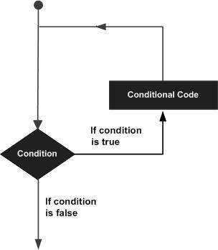
In general, statements are executed sequentially: The first statement in a function is executed first, followed by the second, and so on. There may be a situation when you need to execute a block of code several number of times.
Programming languages provide various control structures that allow for more complicated execution paths.
A loop statement allows us to execute a statement or group of statements multiple times. The diagram on right illustrates a loop statement −

Slide 3
Types of Loops
while loop -- repeats a statement or group of statements infinitely until a given condition is false
for loop -- repeats a statement or group of statements a finite number of times
nested loops -- You can use one or more loop inside any another

Slide 4
while Loop Statements
The while loop is one of the first loops that you'll probably encounter when you're starting to learn how to program. If you think of the name of this loop, you will quickly understand that the word "while" has got to do something with "interval" or a "period of time".
A while loop is a programming concept that, when it's implemented, executes a piece of code over and over again while a given condition still holds true.
The above definition also highlights the three components that you need to construct the while loop in Python:
The while keyword;
A condition that translates to either True or False; And
A block of code that you want to execute repeatedly

Slide 5
while Loop contd….
The syntax of a while loop in Python programming language is −
while expression: statement(s)
Here, statement(s) may be a single statement or a block of statements. The condition may be any expression, and true is any non-zero value. The loop iterates while the condition is true. When the condition becomes false, program control passes to the line immediately following the loop.
Here, key point of the while loop is that the loop might not ever run. When the condition is tested and the result is false, the loop body will be skipped and the first statement after the while loop will be executed.

Slide 6
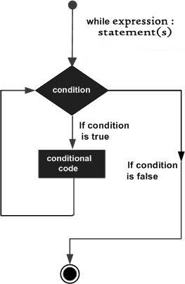
Notes:
Flow Diagram

Slide 7
Example 1
count = 0 while (count < 9): print ('The count is:', count) count = count + 1 print ("Good bye!")

Slide 8
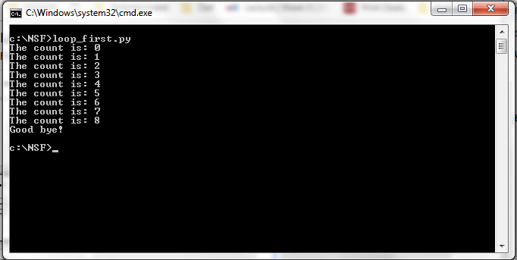
Output

Slide 9
Explanation
The code example above is a very simple while loop: if you think about it, the three components about which you read before are all present: the while keyword, followed by a condition that translates to either True or False (number < 9) and a block of code that you want to execute repeatedly:
print 'The count is:', count count = count + 1
The block here, consisting of the print and increment statements, is executed repeatedly until count is no longer less than 9. With each iteration, the current value of the index count is displayed and then increased by 1.

Slide 10
Example 2
number=2
while number < 10 : # Find the mod of 2 if number%2 == 0: print("The number "+str(number)+" is even") else: print("The number "+str(number)+" is odd") # Increment `number` by 1 number = number+1

Slide 11
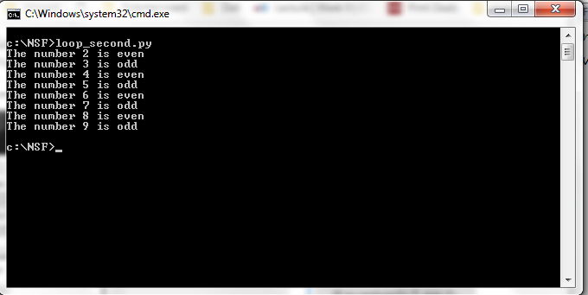
Output

Slide 12
The Infinite Loop
A loop becomes infinite loop if a condition never becomes FALSE. You must use caution when using while loops because of the possibility that this condition never resolves to a FALSE value. This results in a loop that never ends. Such a loop is called an infinite loop.
An infinite loop might be useful in client/server programming where the server needs to run continuously so that client programs can communicate with it as and when required.

Slide 13
Example
var = 1 while var == 1 : # This constructs an infinite loop num = str(input('Enter a number: ')) print ("You entered: ", num) print ("Good bye!")
When the above code is executed, it produces the following result −

Slide 14
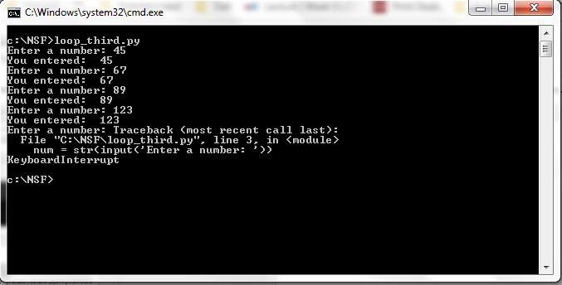
Output
Notes:
Above example goes in an infinite loop and you need to use CTRL+C to exit the program.

Slide 15
Using else Statement with Loops
Python supports to have an else statement associated with a loop statement.
If the else statement is used with a for loop, the else statement is executed when the loop has exhausted iterating the list.
If the else statement is used with a while loop, the else statement is executed when the condition becomes false.
The following example illustrates the combination of an else statement with a while statement that prints a number as long as it is less than 5, otherwise else statement gets executed.

Slide 16
Example
count = 0 while count < 5: print count, " is less than 5" count = count + 1 else: print count, " is not less than 5"
When the above code is executed, it produces the following result −

Slide 17
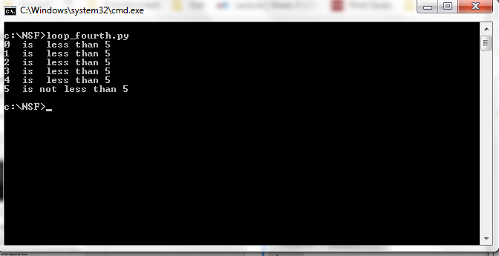
Output

Slide 18
for Loop Statements
A for loop is a programming concept that, when it's implemented, executes a piece of code over and over again "for" a certain number of times, based on a sequence.
In contrast to the while loop, there isn't any condition actively involved - you just execute a piece of code repeatedly for a number of times. In other words, while the while loop keeps on executing the block of code contained within it only till the condition is True, the for loop executes the code contained within it only for a specific number of times. This "number of times" is determined by a sequence or an ordered list of things.

Slide 19
for loop contd...
The following pieces you need in order to create a for loop:
The for keyword
A variable
The in keyword
The code that you want to execute repeatedly

Slide 20
for Loop Statements
Syntax:
for iterating_var in sequence: statements(s)
If a sequence contains an expression list, it is evaluated first. Then, the first item in the sequence is assigned to the iterating variable iterating_var. Next, the statements block is executed. Each item in the list is assigned to iterating_var, and the statement(s) block is executed until the entire sequence is exhausted.

Slide 21
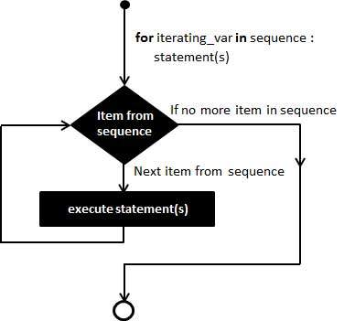

Slide 22
Example
for letter in 'Python': # First Example print ('Current Letter :', letter) fruits = ['banana', 'apple', 'mango'] for fruit in fruits: # Second Example print ('Current fruit :', fruit) print ("Good bye!")
When the above code is executed, it produces the following result −

Slide 23

Output

Slide 24
nested loops
Python programming language allows to use one loop inside another loop. Following section shows few examples to illustrate the concept.
Syntax
for iterating_var in sequence: for iterating_var in sequence: statements(s) statements(s)

Slide 25
nested loops contd...
The syntax for a nested while loop statement in Python programming language is as follows −
while expression: while expression: statement(s) statement(s)
A final note on loop nesting is that you can put any type of loop inside of any other type of loop. For example a for loop can be inside a while loop or vice versa.

Slide 26
Example
The following program uses a nested for loop to find the prime numbers from 2 to 100 −
i = 2 while(i < 100): j = 2 while(j <= (i/j)): if not(i%j): break j = j + 1 if (j > i/j) : print (i, " is prime") i = i + 1 print ("Good bye!")

Slide 27
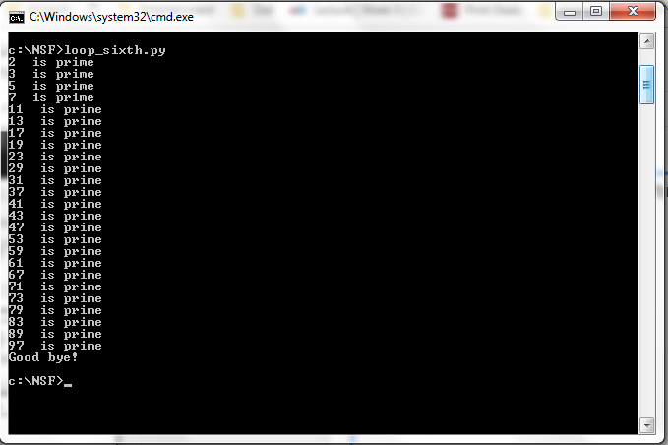
When the above code is executed, it produces following result −

Slide 28
Loop Control Statements
Loop control statements change execution from its normal sequence. When execution leaves a scope, all automatic objects that were created in that scope are destroyed. Let us go through the loop control statements briefly.
break statement -- Terminates the loop statement and transfers execution to the statement immediately following the loop.
continue statement -- Causes the loop to skip the remainder of its body and immediately retest its condition prior to reiterating.
pass statement -- The pass statement in Python is used when a statement is required syntactically but you do not want any command or code to execute.

Slide 29
break statement
It terminates the current loop and resumes execution at the next statement, just like the traditional break statement in C.
The most common use for break is when some external condition is triggered requiring a hasty exit from a loop. The break statement can be used in both while and for loops.
If you are using nested loops, the break statement stops the execution of the innermost loop and start executing the next line of code after the block.
The syntax for a break statement in Python is as follows −
break

Slide 30
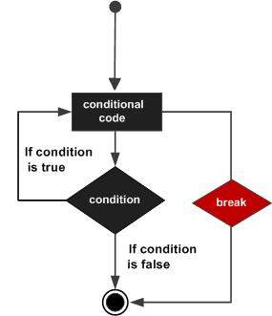

Slide 31
Example
for letter in 'Python': # First Example if letter == 'h': break print ('Current Letter :', letter) var = 10 # Second Example while var > 0: print ('Current variable value :', var) var = var -1 if var == 5: break print ("Good bye!")

Slide 32
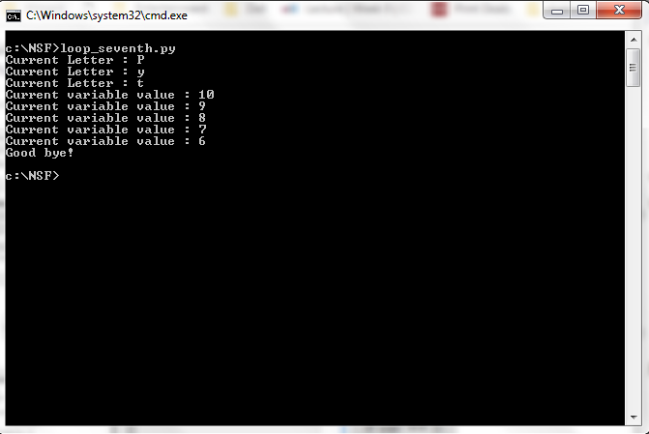
When the above code is executed, it produces the following result −

Slide 33
continue statement
It returns the control to the beginning of the while loop.. The continue statement rejects all the remaining statements in the current iteration of the loop and moves the control back to the top of the loop.
The continue statement can be used in both while and for loops.
Syntax
continue

Slide 34
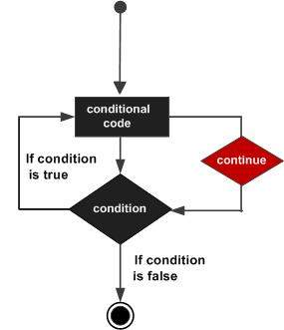

Slide 35
Example
for letter in 'Python': # First Example if letter == 'h': continue print ('Current Letter :', letter) var = 10 # Second Example while var > 0: var = var -1 if var == 5: continue print ('Current variable value :', var) print ("Good bye!"

Slide 36
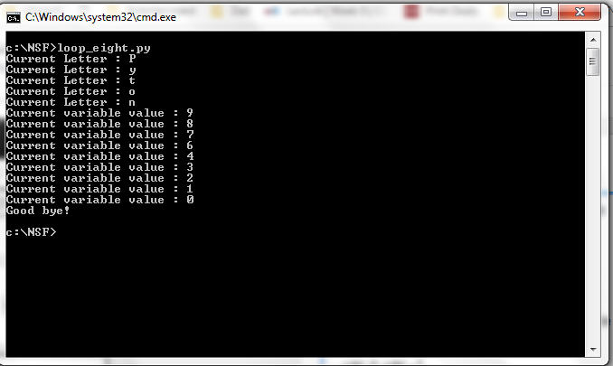
When the above code is executed, it produces the following result −

Slide 37
pass Statement
It is used when a statement is required syntactically but you do not want any command or code to execute.
The pass statement is a null operation; nothing happens when it executes. The pass is also useful in places where your code will eventually go, but has not been written yet (e.g., in stubs for example) −
Syntax
pass

Slide 38
Example
for letter in 'Python': if letter == 'h': pass print ('This is pass block') print ('Current Letter :', letter) print ("Good bye!")

Slide 39

When the above code is executed, it produces following result −

Slide 40
What is range() function?
The range() function returns a sequence of numbers, starting from 0 by default, and increments by 1 (by default), and ends at a specified number.
Syntax
range(start, stop, step)

Slide 41
Parameter Description
start Optional. An integer number specifying at which position to start.
Default is 0
stop Optional. An integer number specifying at which position to end.
step Optional. An integer number specifying the incrementation.
Default is 1

Slide 42
Example
Create a sequence of numbers from 3 to 5, and print each item in the sequence:
x = range(3, 6)
for n in x:
print(n)

Slide 43
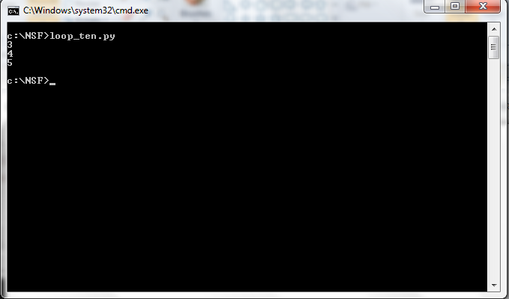
Output

Slide 44
Example 2
Create a sequence of numbers from 3 to 20, but increment by 2 instead of 1:
x = range(3, 20, 2)
for n in x:
print(n)

Slide 45
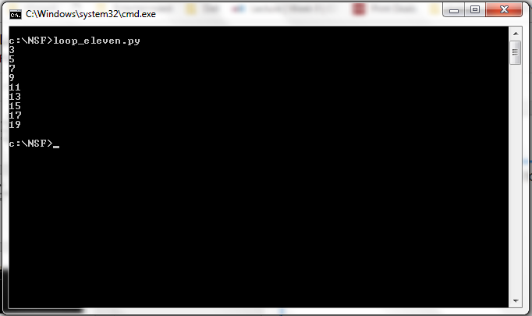
Output

